Slide 1


Slide 2
Java and Version Control
Zach Merrill
System Application Developer
James Getrost
System Application Developer Intern

Slide 3
Agenda
The Java Platform
Application Basics
Control Structures
Version Control with Git

Slide 4
The Java Platform
Introduction To Java Programming

Slide 5

The Java Platform
Java is a “concurrent, class-based, object-oriented” programming language
The Java platform is a software system for cross-platform development and deployment
Write Once, Run Anywhere
Duke, the Java mascot

Slide 6
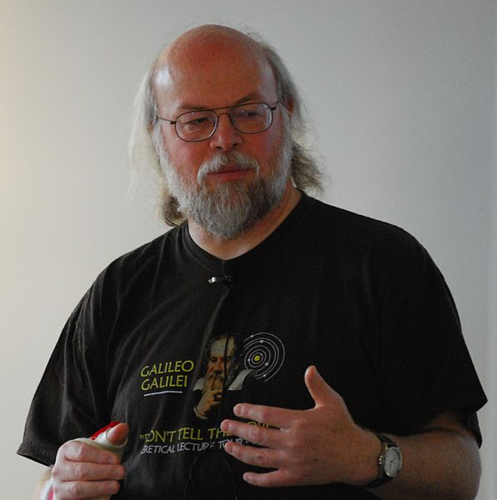
History of Java
Developed by James Gosling at Sun Microsystems from 1991 to 1995
Derived from the C and C++ languages
Aimed to simplify the development process by removing some of the low-level management, i.e. pointers, garbage collection, memory allocation
Very popular thanks to ability to run almost anywhere
James Gosling

Slide 7
Where can you find Java?
Desktop applications
Web development (J2EE, JSP/JSF, Struts, GWT)
Servers
Android Phones
Printers
Cars
ATMs
Parking Meters
Toasters
…Basically everywhere

Slide 8
Principles
It should be "simple, object-oriented and familiar"
It should be "robust and secure"
It should be "architecture-neutral and portable"
It should execute with "high performance"
It should be "interpreted, threaded, and dynamic"
http://www.oracle.com/technetwork/java/intro-141325.html

Slide 9
simple, object-oriented and familiar
Fundamentals can be grasped quickly
Built to be object-oriented (major shift from earlier languages)
3rd party libraries that can be used across thousands of applications and extended to fit needs
Kept “look and feel” of C++

Slide 10
robust and secure
Reliable design
Checks code during compilation and again during runtime
Handles memory management to prevent leaks and security issues

Slide 11
architecture-neutral and portable
All Java applications run on the Java Virtual Machine (JVM)
The JVM is a piece of software that is implemented for each target architecture
Java code is compiled and run on the JVM; the JVM makes sure the program is executed no matter where it is running
Note the JVM is not cross-platform

Slide 12
high performance
Garbage collection is automated to ensure memory is available when it is needed
This is one area where Java sometimes falls short
Because we give up some of the low level functions to automation they can be less efficient

Slide 13
interpreted, threaded, and dynamic
Multithreading is an advanced but important topic
Included native in Java
Modern processors have many cores: dual and quad are common in consumer chips. Some have over 100 cores
Without multithreading only one instruction is possible at a time
Tons of wasted CPU cycles!

Slide 14
Why use Java over other languages?
Cross-platform – Write Once, Run Everywhere
Relatively easy to learn
Countless 3rd party libraries
Memory management/garbage collection
Tons of great tools (like the Eclipse IDE)
Huge pool of knowledge from decades of development
Preferred language of many large companies
No pointers!

Slide 15
Application Basics
Introduction To Java Programming

Slide 16
Primitive Variables
All variables must be declared and cannot be null! (much different than Python, Perl or Ruby)
byte – 8 bit integer, from -128 to 127
short – 16 bit integer from -32,768 to 32,767
int – 32 bit integer from -2³¹ to 2³¹ - 1
long – 64 bit integer from -2⁶³ to 2⁶³ - 1
float – decimal value
double – decimal value, precision 2
boolean – true or false
char – single character (same size as short)

Slide 17
Reference Variables
String is not a primitive! They are essentially arrays of chars.
“a” != ‘a’
All primitives have a “wrapper class”
int becomes Integer
long becomes Long
char becomes Character
etc
These classes inherit from the base Object class and can be null
They refer to actual Objects

Slide 18
Lets print a line of text
//Lets print a line of text
public class HelloWorld{
// This is the ‘main method’ it begins
// execution of a Java app
public static void main(String[] args){
System.out.println("Hello World!!!");
}
// curly braces closes a block!
}

Slide 19
String Formatting
Escape Secuence | Description
\t | Inserts a tab in the text.
\n | Inserts a newline in the text.
\\ | Inserts a backslash in the text.
\” | Inserts a double quote in the text.
\’ | Inserts a double quote in the text.
What will be the result of this statement?
System.out.println("\\/\"PRINT\"\\/\n\t\'print\'");

Slide 20
String Formatting cont.
Format a string using the System.out.printf() method.
Format Specifier | Description
%d | Formats value as a decimal.
%f | Formats value as a floating point.
%s | Formats value as a string.
%n | Outputs a platform-specific line terminator.
%% | Outputs a percent sign.
double price = 15.00;
System.out.println(price); //15.0
System.out.printf("%f%n", price); //15.000000
System.out.printf(“%.2f%n”, price); //15.00
System.out.printf(“The price is $%.2f.%n”, price);
//The price is $15.00.

Slide 21
Getting User Input
Use the Scanner from the java.util package.
import java.util.Scanner;
public class UserInput {
public static void main(String[] args){
Scanner input = new Scanner(System.in);
System.out.println(“What is your name?”);
String name = input.next();
System.out.printf(“Hello %s\n”, name);
}
}

Slide 22
Lets do some addition!
import java.util.Scanner;
public class Addition {
public static void main(String[] args) {
// A scanner reads input from the user
Scanner input = new Scanner(System.in);
int number1;
int number2;
int sum;
System.out.print("Enter the first integer: ");
number1 = input.nextInt();

Slide 23
Lets do some addition!
System.out.print("Enter the second integer: ");
number2 = input.nextInt();
sum = number1 + number2;
System.out.printf("Sum is %d\n", sum);
}
}

Slide 24
Lets do some addition!
int number1;
Each variable has a name: “number1”
Each variable has a type: “int”
Each variable has a size
number1 = input.nextInt();
A variable refers to a specific location in memory.
When assignment occurs the old value is overwritten by the new value

Slide 25
More Math!
Operation | Operator | Algebra | Java
Addition | + | f + 7 | f + 7
Subtraction | - | p – c | p – c
Multiplication | * | xy | x * y
Division | / | x / y | x / y
Remainder (Mod) | % | r mod s | r % s

Slide 26
More Math!
Multiplication, division and remainder are evaluated first, left to right (associativity)
Addition and subtraction is next, left to right
Assignment is always last, right to left

Slide 27
More Math!
Std Operator | Java Operator | Sample | Meaning
Equality
= | == | X == y | X is equal to y
≠ | != | X != y | X is not equal to y
Relational
> | > | X > y | X is greater than y
< | < | X < y | X is less than y
≥ | >= | X >= y | X is greater than or equal to y
≤ | <= | X <= y | X is less than or equal to y

Slide 28
Control Statements
Introduction To Java Programming

Slide 29
If / Else if / Else Statements
if (x > 5){
System.out.println(“x is greater than 5!”);
}
else if (x < 5){
System.out.println(“x is less than 5!”);
}
else{
System.out.println(“x must be five 5!”);
}

Slide 30
while Repetition Statements
while(x < 100){
System.out.println(“X is “ + x);
x++;
}
While loops are a good way to repeat a statement for an unknown number of objects (sentinel controlled), or to create a counter controlled loop

Slide 31
while Repetition Statements
What’s wrong with these?
x = 1;
while(x >= 0){
System.out.println(x);
x++;
}
-----------------------------------------------------------------
x = 0;
Y = 0;
while(x > 0){
System.out.print(“Enter a number: “);
y = input.nextInt();
System.out.println(“Was this your number? “ + y);
x++;
}

Slide 32
do...while Repetition Statement
int counter = 1;
do{
System.out.println(counter);
counter++;
}while(counter <= 10);
What’s the difference?

Slide 33
for Repetition Statements
for (int counter = 1; counter <= 10; counter++){
System.out.printf(“%d, “, counter);
}
for loops are literally the same thing as a counter controlled while loop
General format:
for( initialization; condition; increment)
statement

Slide 34
switch Statements
public void doSwitch(int x){
switch (x){
case 1:
System.out.println(“1”);
break;
case 2:
System.out.println(“2”);
break;
default:
System.out.println(“Not 1 or 2”);
break;
}
}

Slide 35
Control Structures Can Be Nested
while(x < 100){
if (x < 50)
System.out.println(“x is less than 50”);
else if (x > 50)
System.out.println(“x is greater than 50”);
x++;
}
for(x = 0; x < 100; x++){
if (x < 50)
System.out.println(“x is less than 50”);
else if (x > 50)
System.out.println(“x is greater than 50”);
}

Slide 36
Consider this…
public void compareValues(long hugeNumber){
for(x = 0; x < hugeNumber; x++){
for(y = 0; y < hugeNumber; y++){
if(x != y){
if(x < y){
doSomething(y);
}else{
doSomething(x);
}
}
}
}
}

Slide 37
Break and Continue
The keyword ‘break’ will terminate the loop immediately and move on to the next code after the loop
The keyword ‘continue’ will skip the rest of the code in the block and move on to the next loop

Slide 38
Logical Operators
&& means ‘and’
if (x > 10 && x < 20){}
|| means ‘or’
if (x < 10 || x > 20){}
! means ‘not’
if (!isTrue){}
What’s wrong with this?
if (x < 10 && x > 20){}

Slide 39
Version Control with git
Introduction To Java Programming

Slide 40
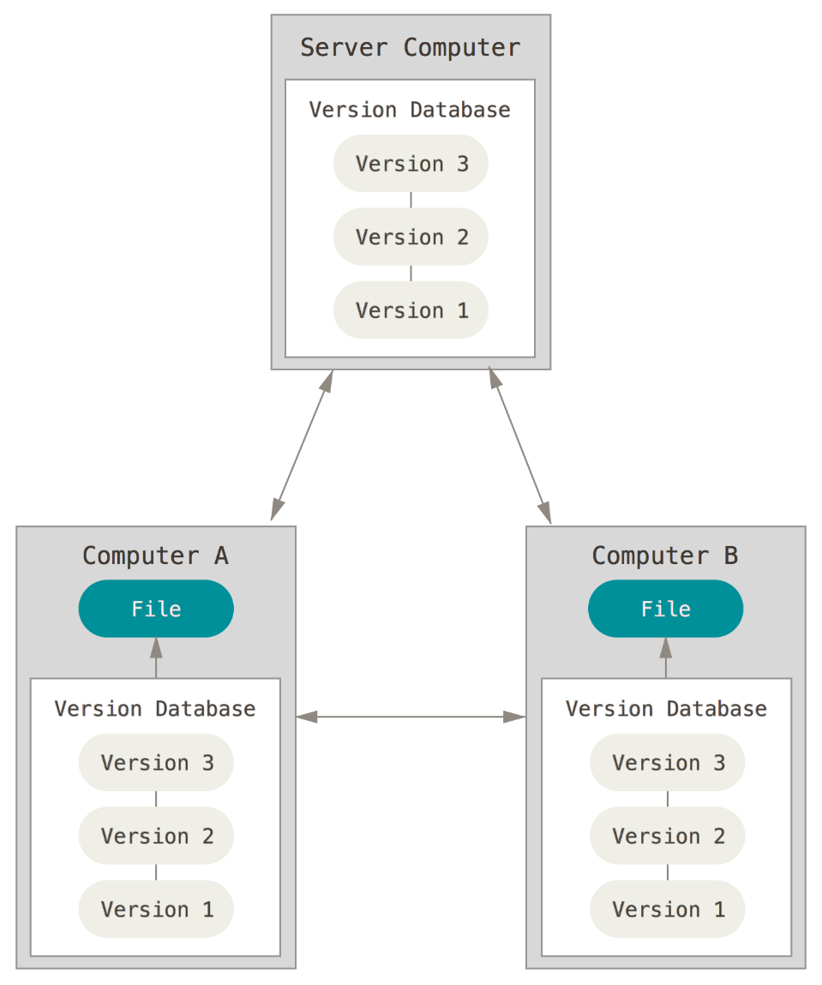
Version Control Systems
System that records changes to files over time so that you can recall specific versions later
Works on any type of file or directory
A VCS allows you to work without fear of breaking a project, as you can easily recover previous work.
Changes can be stored remotely on sites like GitHub

Slide 41
Version control commands
git init – create a new repo
git clone /path/to/repo – check out an existing repo
git add <file> - add files to version control
git commit –m “Message Here” – save changes
git push origin master – push to remote repo (i.e. GitHub)
git status – list all changes since last commit
git pull – get changes from remote repo
Find more here: https://confluence.atlassian.com/display/STASH/Basic+Git+commands

Slide 42
Summary
The Java Platform
Application Basics
Control Structures
Version Control with Git

Slide 43
Resources
Java Docs: http://docs.oracle.com/javase/8/docs/api/
Git Reference: http://gitref.org/
GitHub Help: https://help.github.com/

